Slide 1






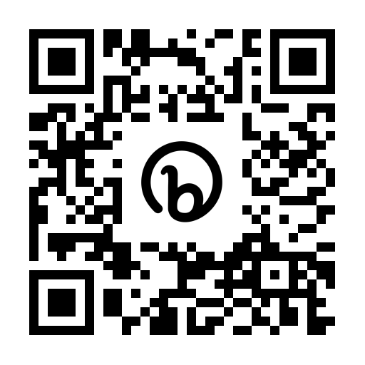
EDA 610:
NU Attend a Board Meeting Assignment 2
Professor Adam Bernstein
Student: Dr. Kenneth M. Hill
Dr. Kenneth M. Hill

Slide 2
Agenda:
Overview of the SGB Agenda
Interactions Among Participants
Role of the Administrators
One Item to Discuss in Detail
Review
Updates
Exit
COS
DOK
SOSA

Slide 3
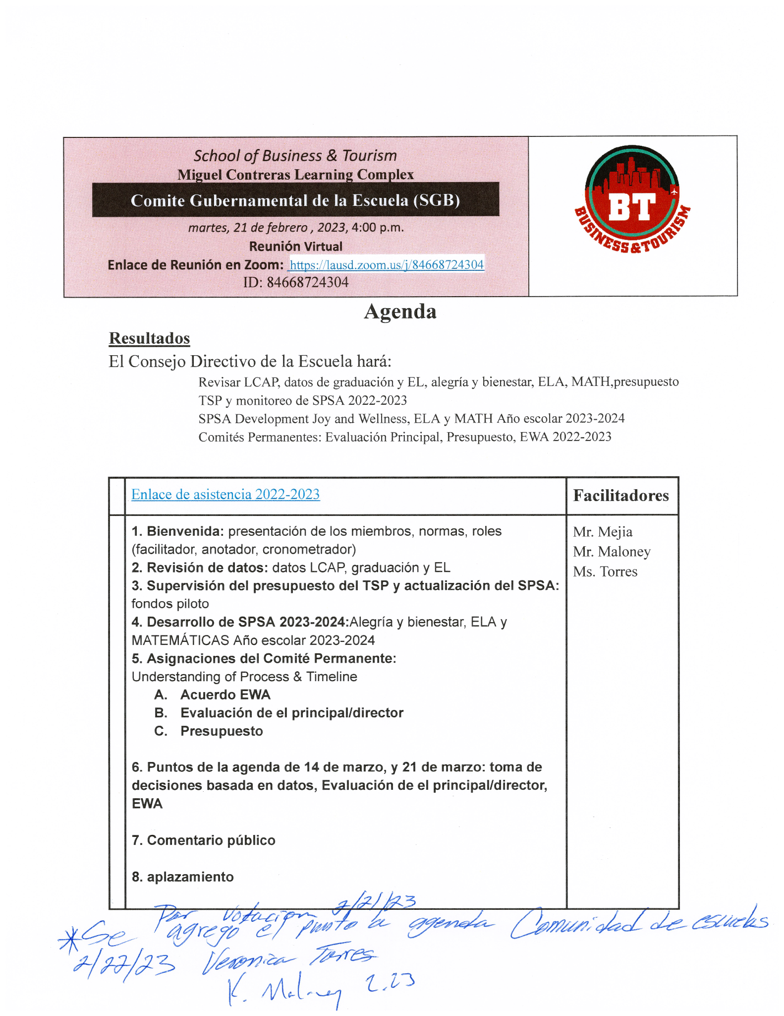
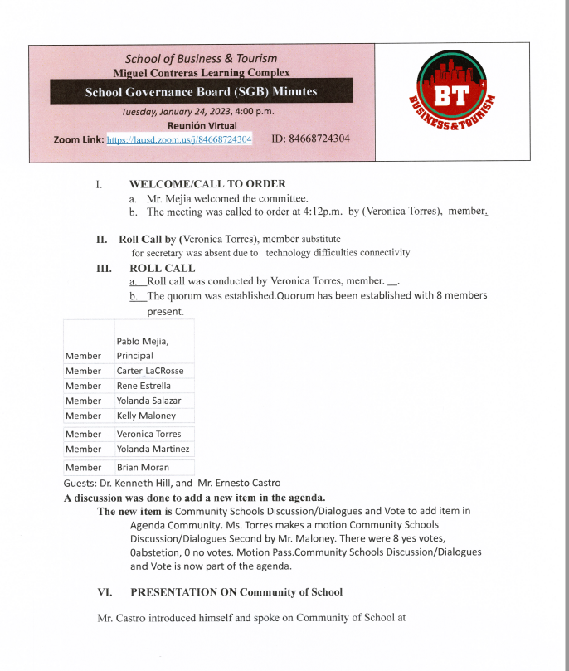
School Governing Board (SGB) Agenda:
Review
Updates
COS
DOK
SOSA

Slide 4
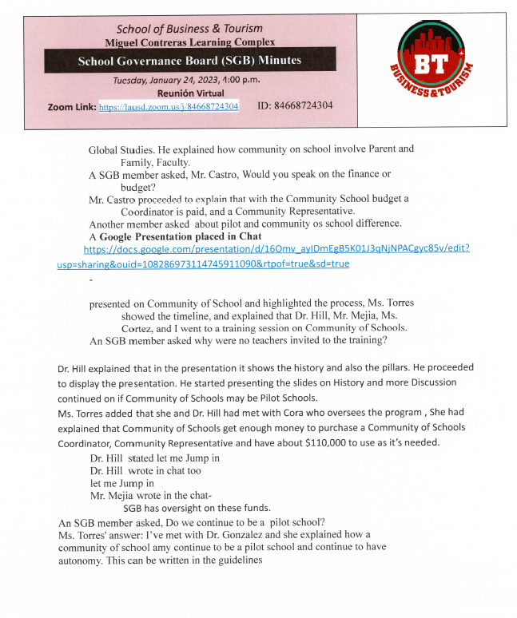
Interactions Among Participants:
Review
Updates
Exit
COS
DOK
SOSA

Slide 5
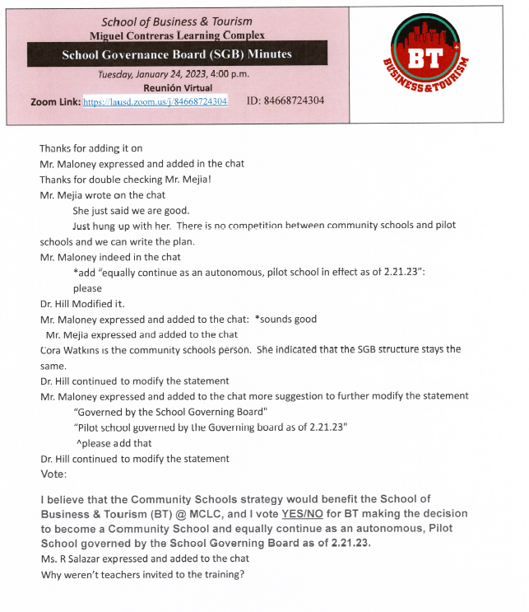
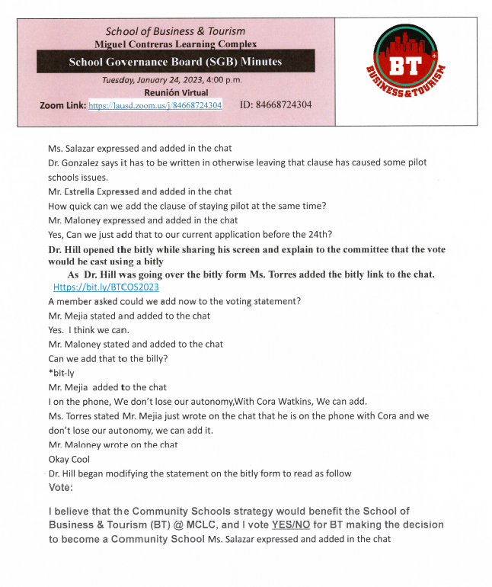
Interactions Among Participants contd:
Updates
Exit
COS
DOK
SOSA

Slide 6
Role of the Administrators:
SGB Host: TSP Coordinator: Ms. Torres
SGB Member Administrator: Principal Mr. Mejia
SGB Guest Speaker Administrator: Principal Ernest Castro
SGB Guest Speaker Administrator: Assistant Principal Dr. Kenneth Hill
Review
Updates
Exit
COS
DOK
SOSA

Slide 7
One Item to Discuss in Detail:
Community School Adoption Presentation Slides 8-19
Review
Updates
Exit
COS
DOK
SOSA

Slide 8
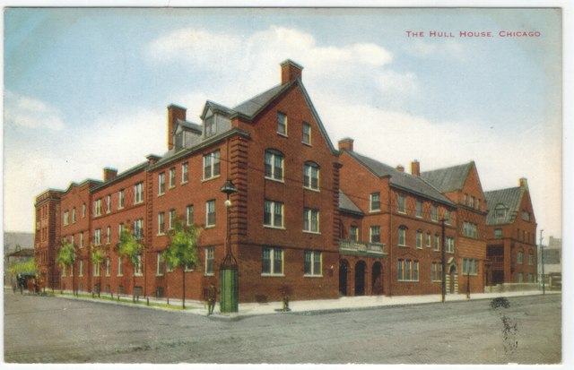

Community Schools is not a new idea.
1889-1935
1899-1950

Slide 9
Leonard Covello, 1938
The school must necessarily become the center of community life in its own neighborhood … It must establish intimate contacts with the child, the adults, the homes, the welfare organizations, and even the business interests of the community.

Slide 10

Principles of Community Schools

Slide 11
Cohort 4 Guidance for Community School Designation
Mr. Castro
Step 1
  Read the Commitment Form
    SGB review
      Commitment to Appropriate Use of Funds
        General Funds: $250,000 in 2023-2024 & 2024-25
          CS Coordinator & Community Rep positions
        In addition, $100,000 and $124,000 in “pending distribution” for use at the school’s discretion with consent of the SGB
            Submit a budget worksheet: Aligned to the 4 Pillars

Slide 12
Cohort 4 Guidance for Community School Designation
Step 2
    Commitment to Hire a Community School Coordinator (CSC)
      Full-time, certificated CSC
        Certificated LAUSD employee & UTLA
          Hiring committee
          Principal & BT UTLA members VOTE

Slide 13
Cohort 4 Guidance for Community School Designation
Step 3
  Commitment to Support Required Training for the CSC
    Collaborative Team Meetings (CTMs)
    Monthly Professional Development
    National Education Association (NEA) Community School Coordinator Curriculum
    Monthly coaching sessions with a Coach

Slide 14
Cohort 4 Guidance for Community School Designation
Step 4
  Commitment to Hire a Community Schools 6 Hour Community Rep
    6-hour, Community School Community Representative
      Specific roles/responsibilities
        Parent/family/community engagement

Slide 15
Cohort 4 Guidance for Community School Designation
Step 5
  Commitment of Two Benchmarks:
    Build the CS Team
    Mapping Project
    Needs & Assets Assessment
      75-100% of stakeholders

Slide 16
Cohort 4 Guidance for Community School Designation
Step 6
  Commitment to Equitable Grading and Instruction (EGI) Training
    Completion June 30, 2024
    Implementation by August, 2024
      Six two-hour workshops
        2 to 3 weeks apart
        8 hours of asynchronous Schoology learning

Slide 17
Cohort 4 Guidance for Community School Designation
Step 7
Commitment to Comply with Documentation and Progress Monitoring Requirements
  Document Community School journey
    submit self- evaluations
    engage in the use of Benchmark Assessment Tools
      Due by May, 2024 and each May
        Events calendar for the entire school year
        Participation in interviews with external evaluator

Slide 18
Cohort 4 Guidance for Community School Designation
Step 8
Click to “VOTE”
https://bit.ly/BTCOS2023
SGB Votes:
I believe that the Community Schools strategy would benefit the School of Business & Tourism (BT) @ MCLC, and I vote NO/YES for BT making the decision to become a Community School.
▢ Yes
▢ No

Slide 19
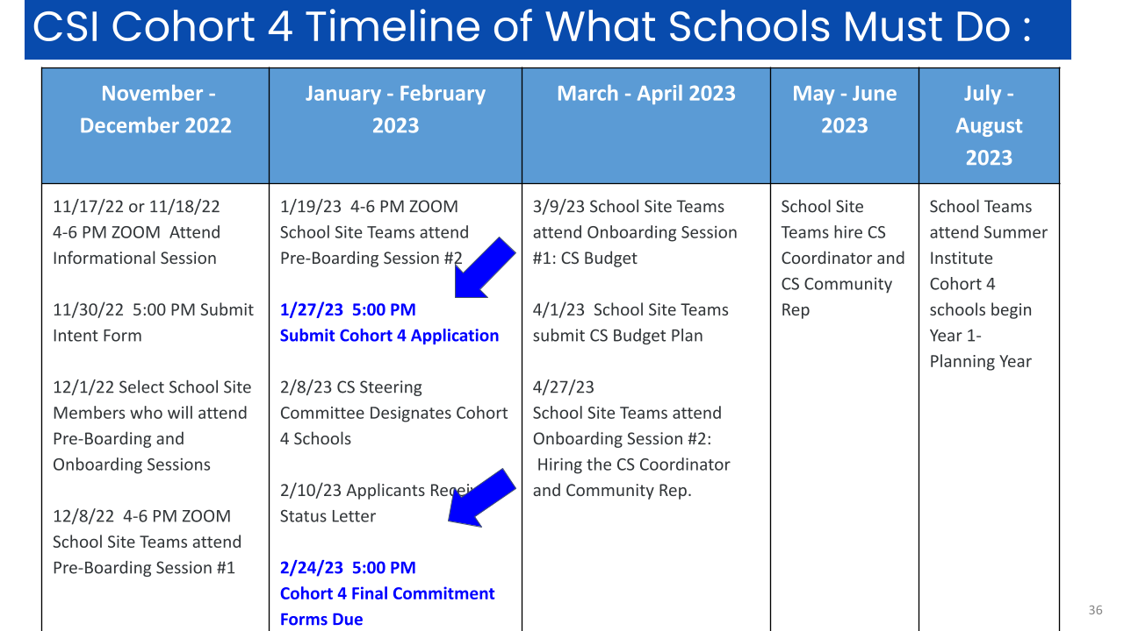
Resources:
Flyer/Report
  Heart of the Community Flyer
  Learning Policy Institute Report
Videos to share
  Farmdale Video SPANISH
  Farmdale Video ENGLISH
  What is a Community School
Community School
  Cohort 4 for the 2023-23 school year
  Frequently Asked Questions Document

