Slide 1






Agenda
i-Ready Intro
Data Utility
Student Achievement
i-Ready Parent Introduction
12.10.23
Student Outcomes
Assessment Administered
EDA 611 Multiple Measures: Dr. Kenneth M. Hill
Notes:
Hill

Slide 2
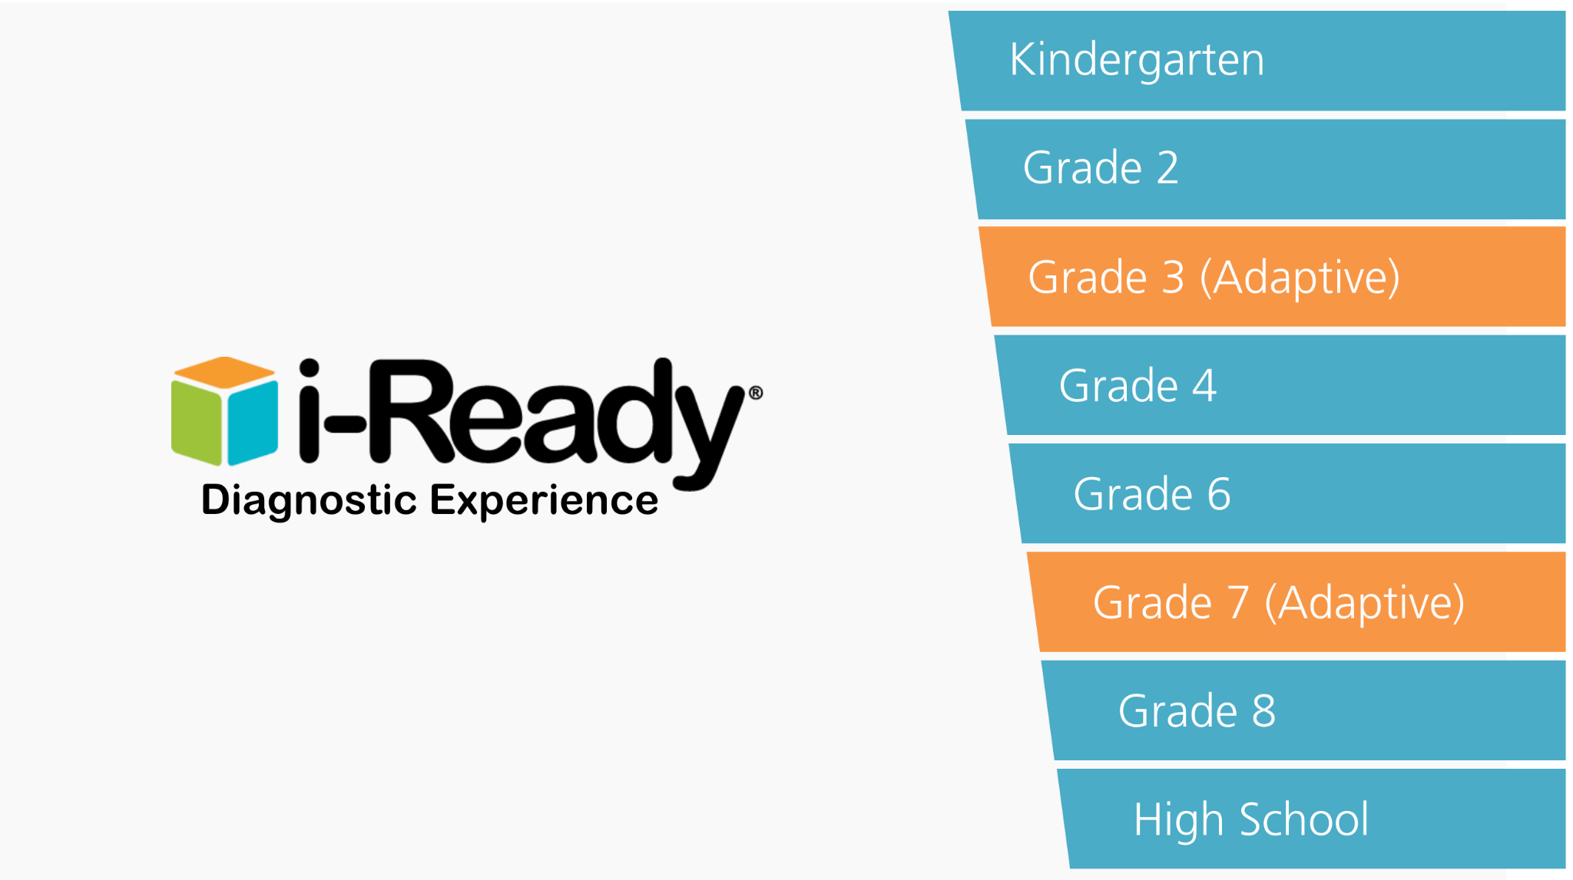

i-Ready Intro
ELA & MATH Pre, Mid, and Post Measurements
Notes:
Almanza: Walks thru the Simulator

Slide 3
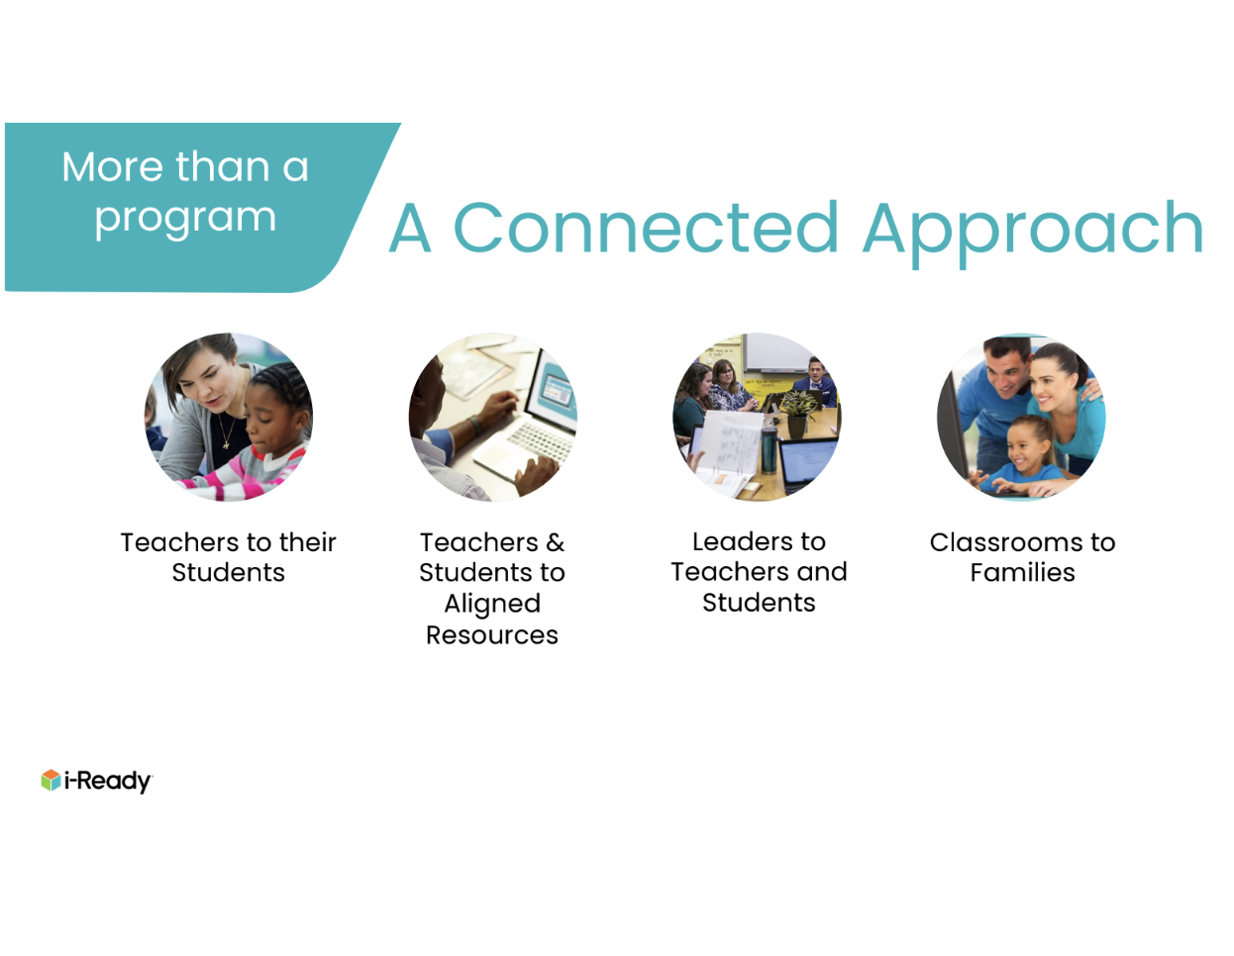
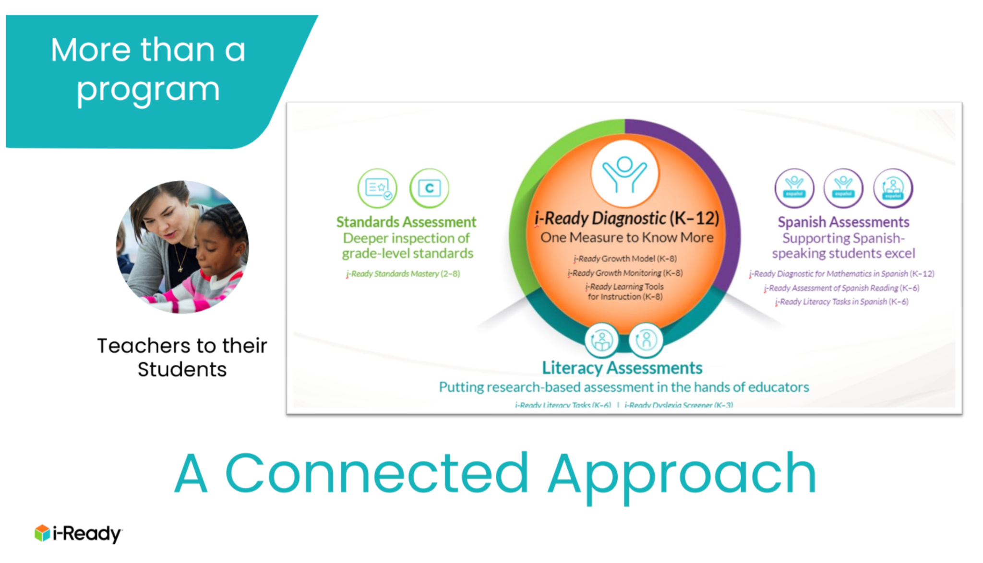
i-Ready Intro

Slide 4
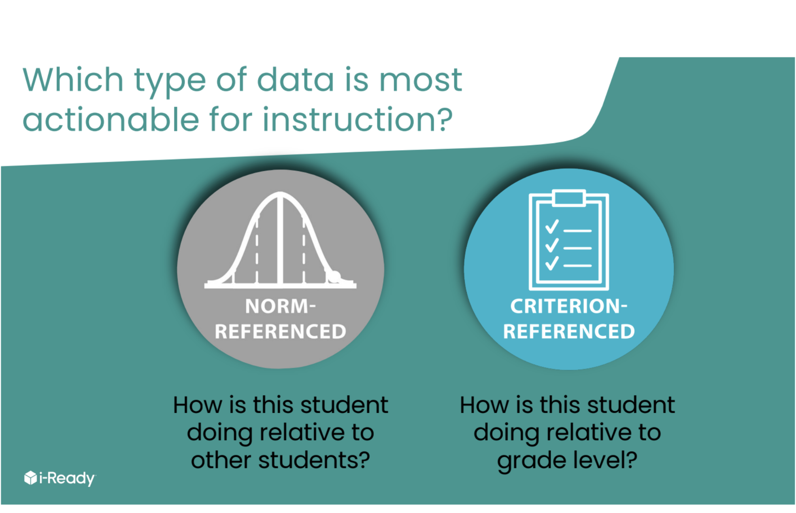
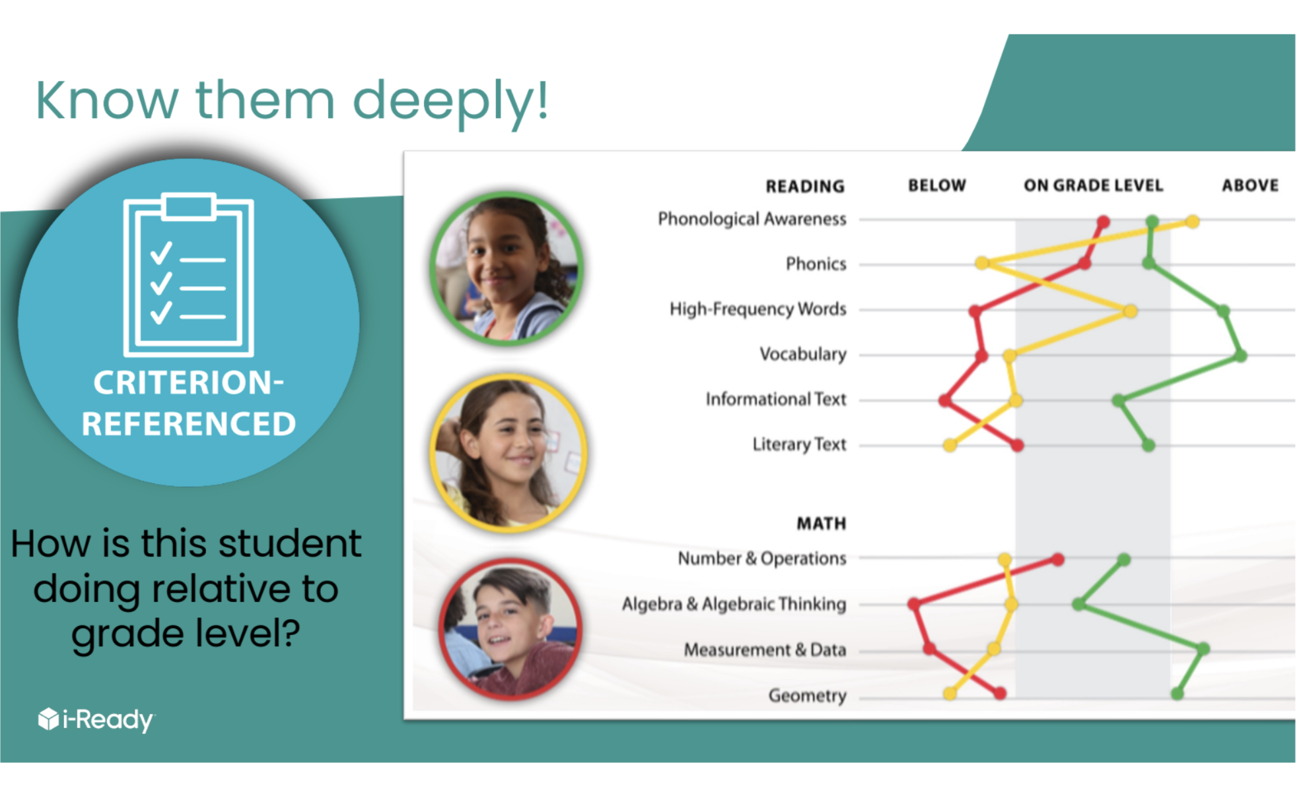
Student Achievement

Slide 5

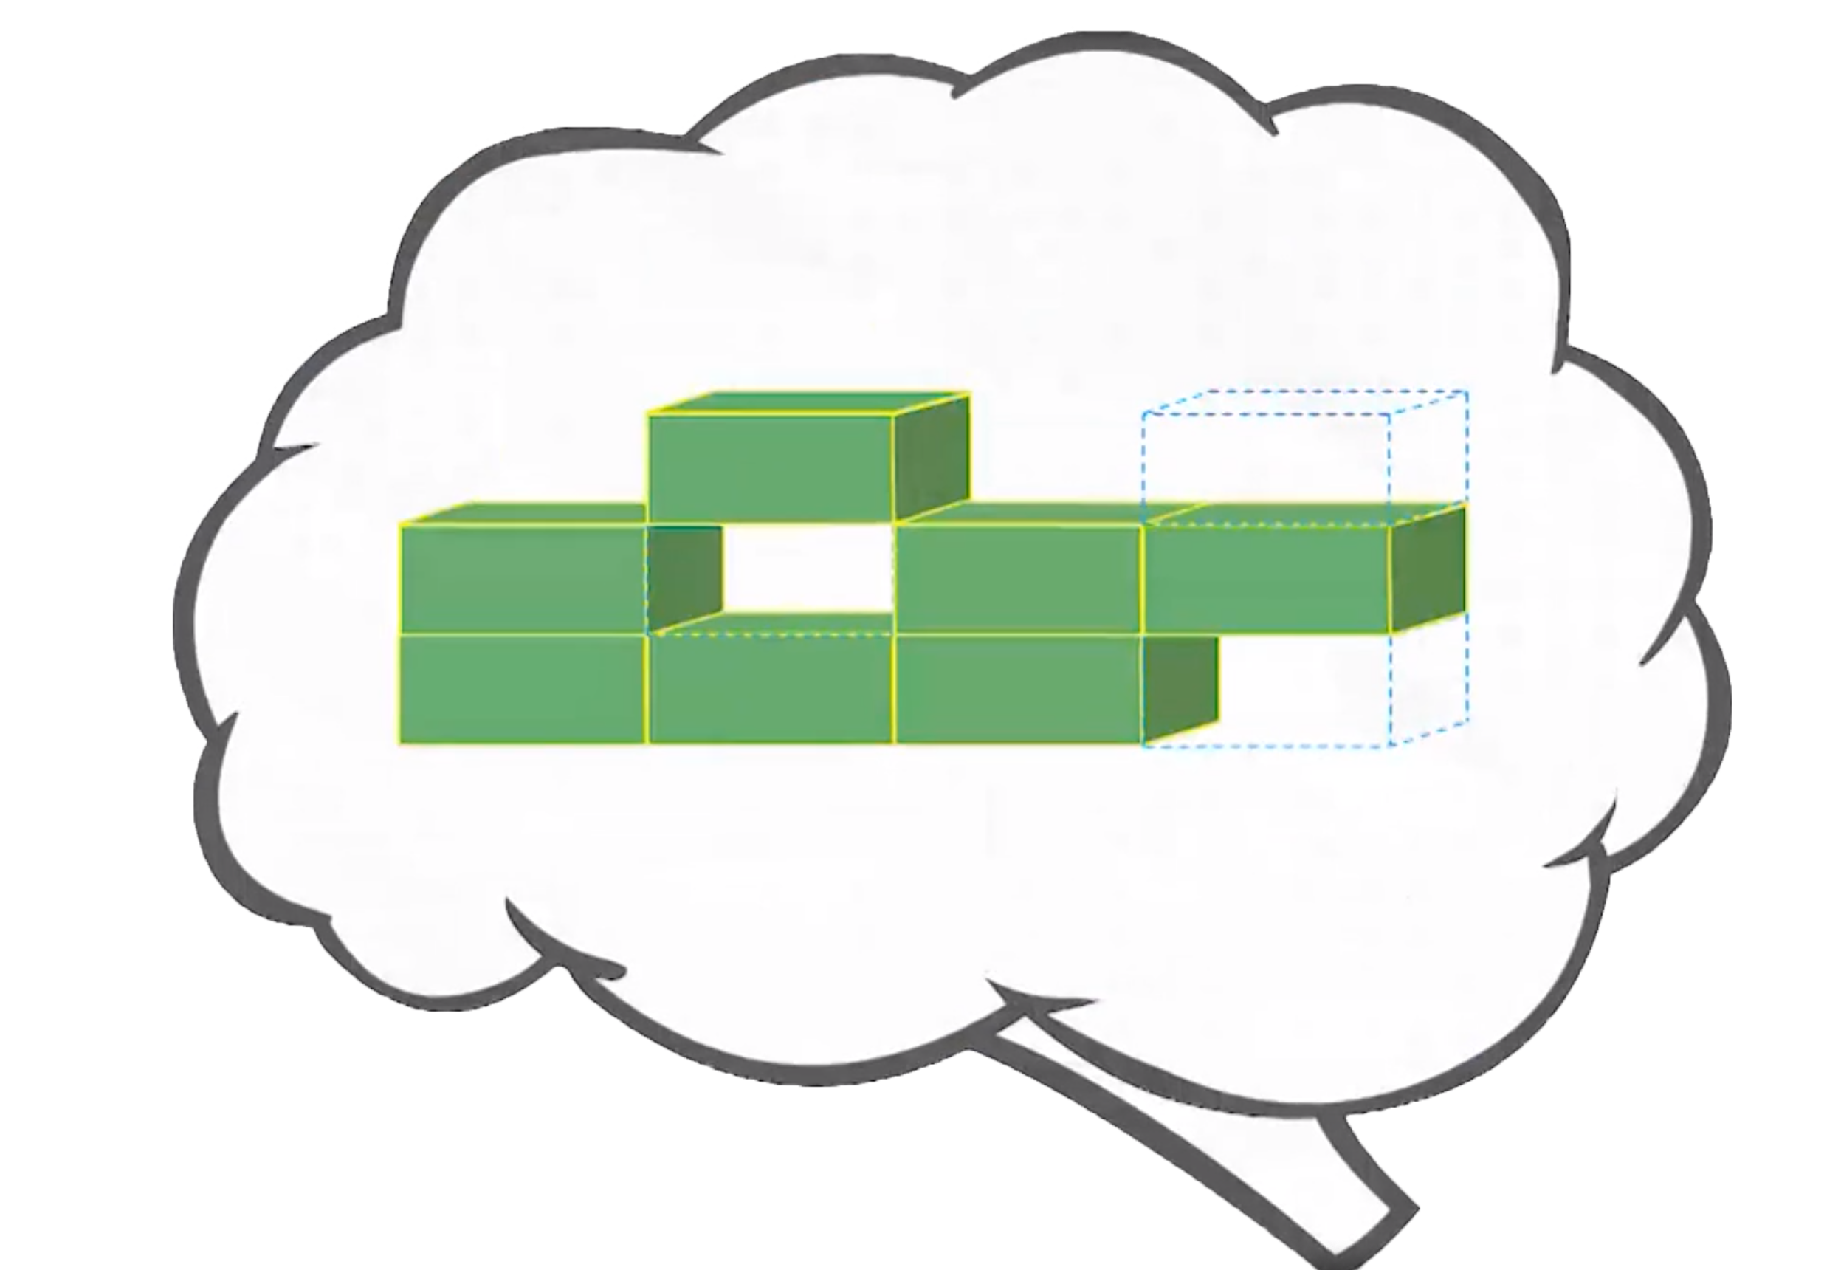
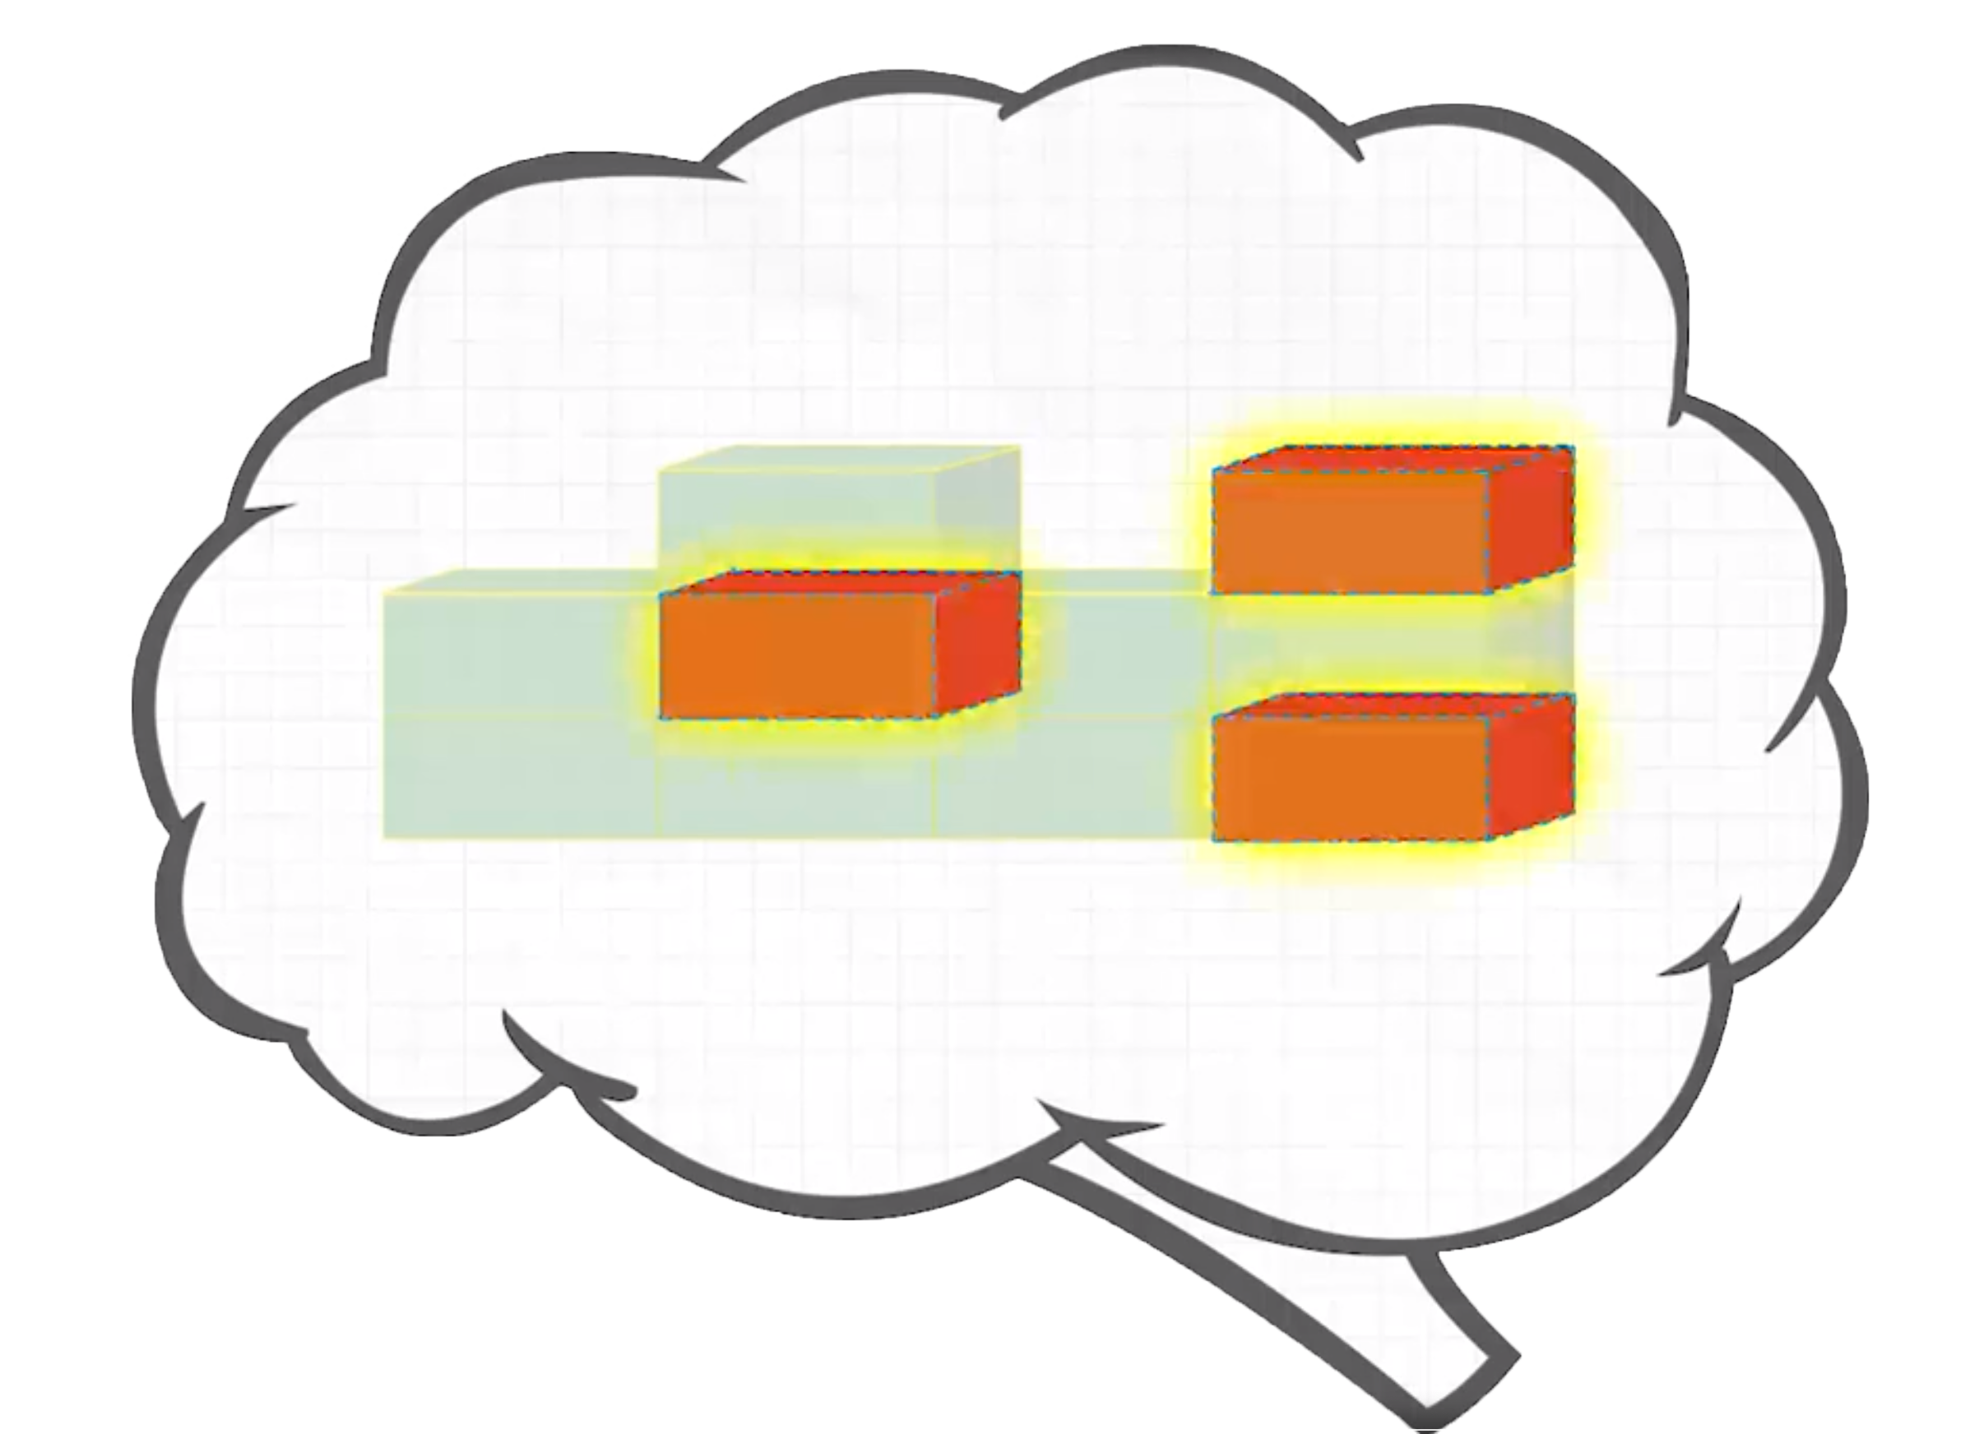
Assessment Administered
“Assessment Administered”
Understand what you
already know
and what you
need to learn
Notes:
Acosta

Slide 6



Assessment Administered
How does the Diagnostic work?
i-Ready is an adaptive test. This means the questions change based on your answers.
Some questions will be . . .
HARD
EASY
JUST RIGHT
Notes:
Acosta

Slide 7
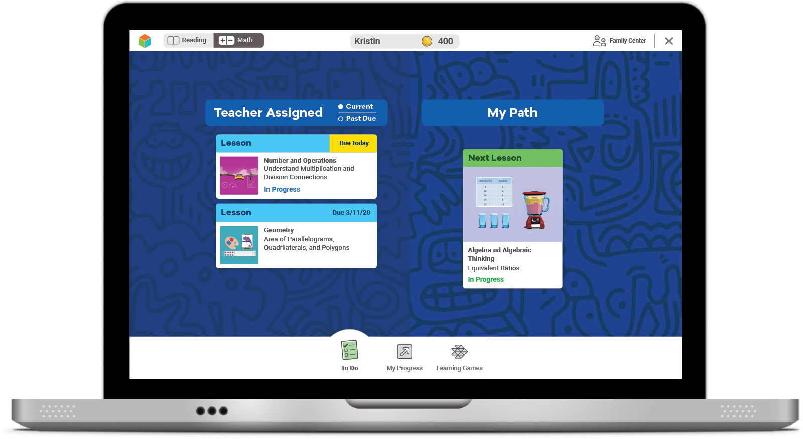
Student Outcomes
Student Outcomes
If you try your best on the Diagnostic,
lessons will match what you need to learn.
The results of your Diagnostic decide
what lessons you will get.

Slide 8
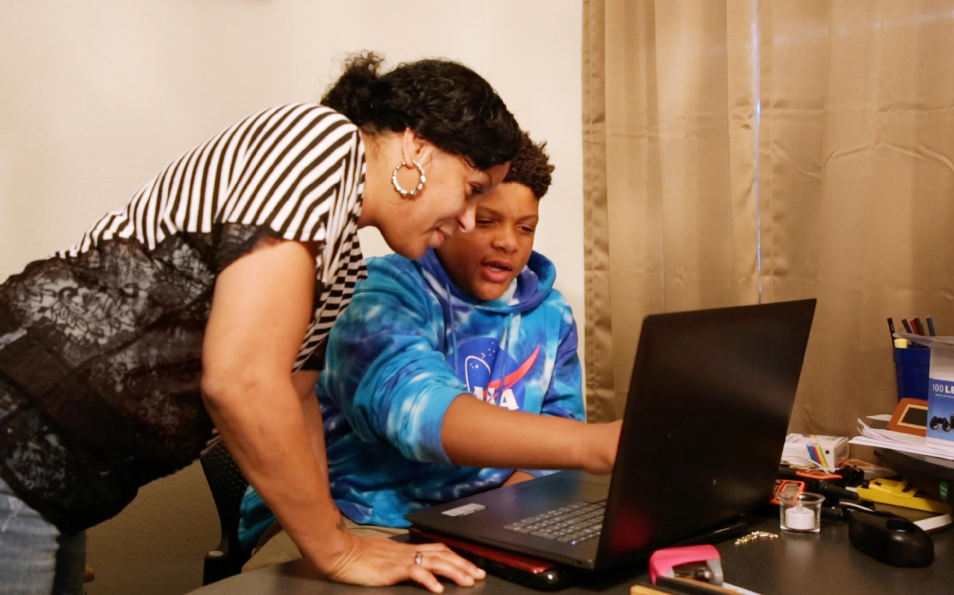
Student Outcomes
Tailored Report
After the Diagnostic, i-Ready creates a special report for you and your family.

Slide 9
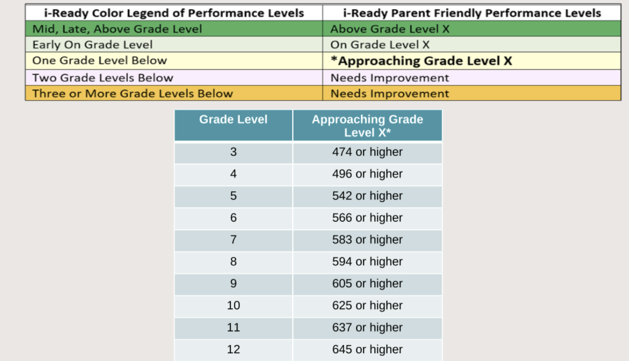
Data Utility
For example: Performance Levels

Slide 10
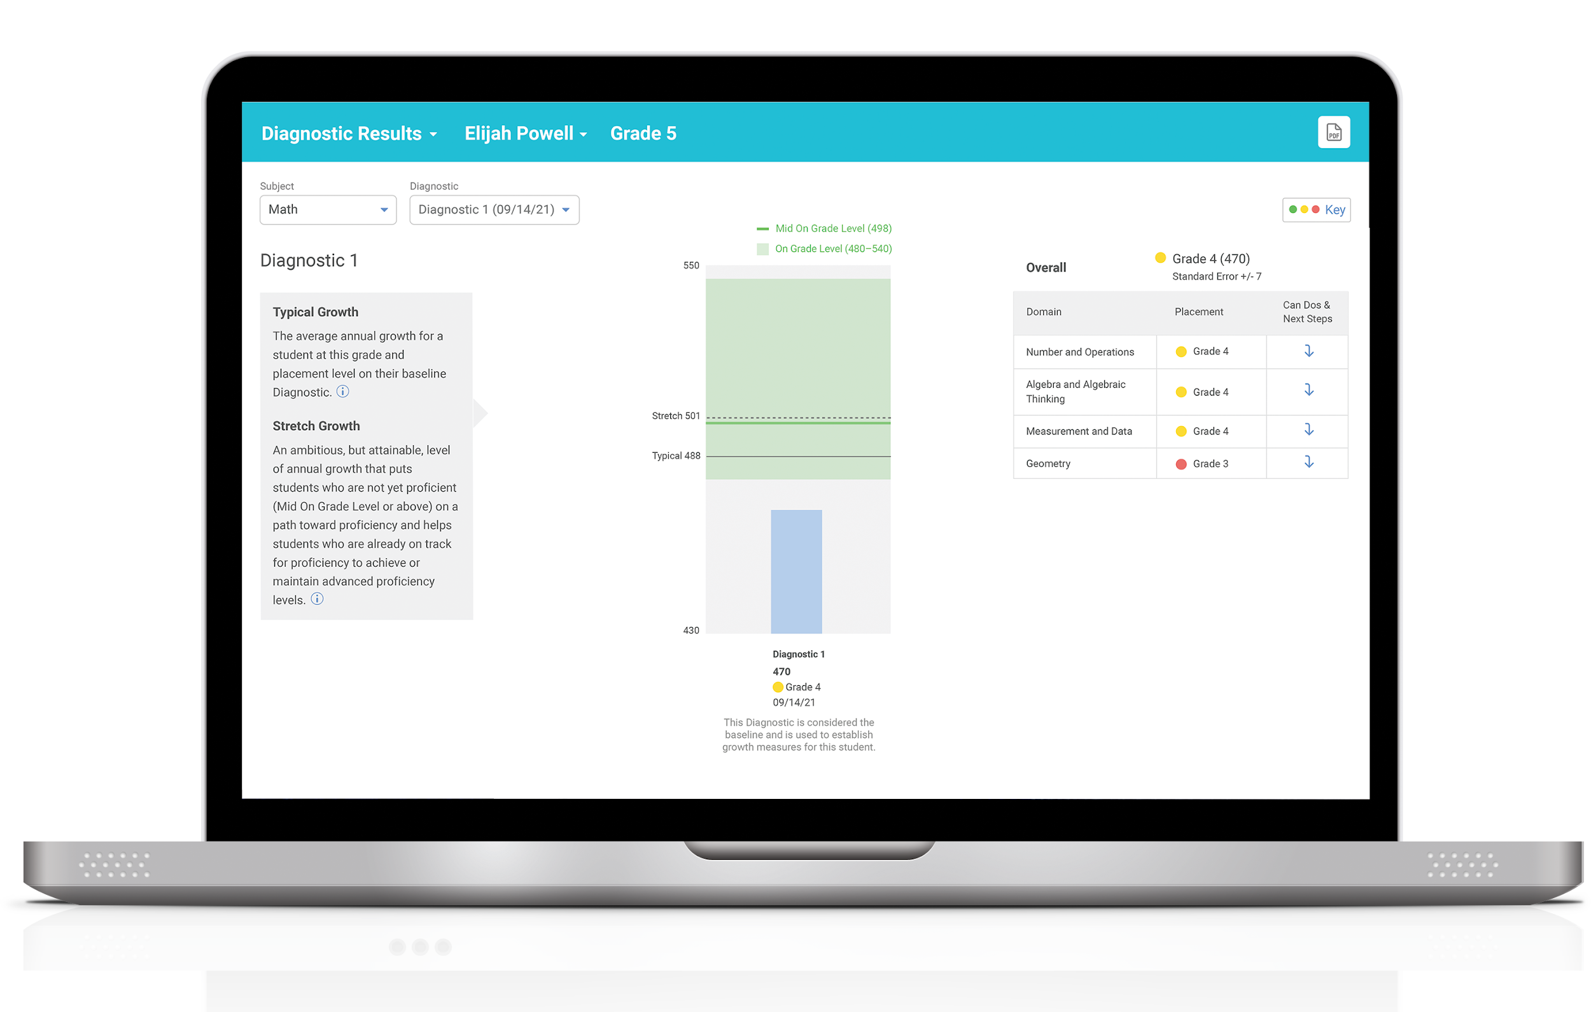
Progress toward your growth goals
Your strengths and areas for growth
How you did
Data Utility
After the Diagnostic, we can
review your results and goals.

Slide 11
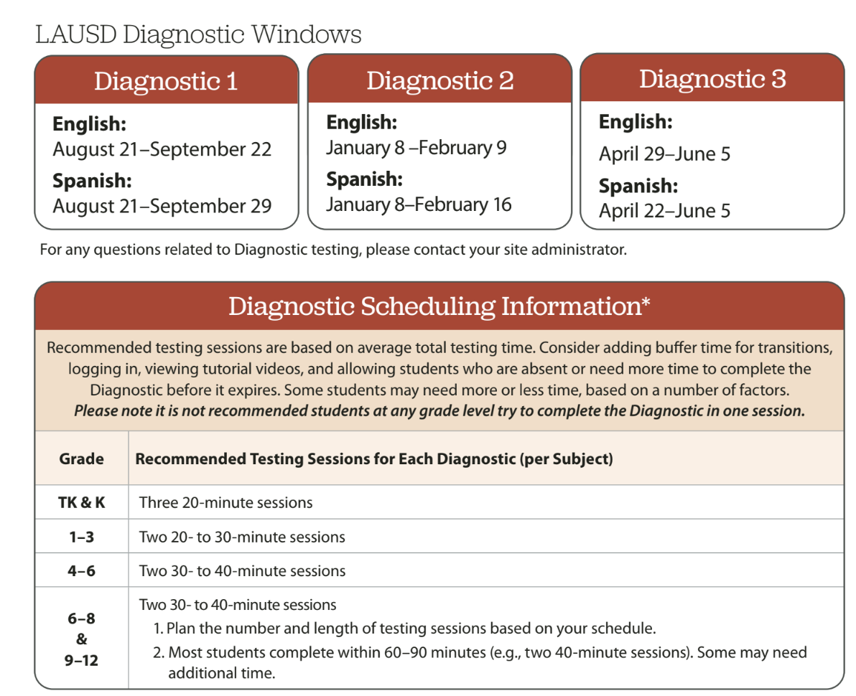
Data Utility: Diagnostic 1-3

